Slide 1
DISTRACTED DRIVER DETECTION USING CNN
Presented by,
Deepa Unnikrishnan
Minal Suresh
Pooja Patidar
Rinu Moideenkutty

Slide 2
CONTENTS
Introduction
Dataset
Data Classes
Methodology
Building the model
Compiling the model
Training the model
Saving the model
Using the model to make predictions
Result
Conclusion
Source

Slide 3
INTRODUCTION
As per the report of National Crime Research Bureau (NCRB), Govt. of India, Indian roads account for the highest fatalities in the world.
As per the survey of National Highway Traffic Safety Administrator, nearly one in five motor vehicle crashes are caused by distracted driver.
In this paper, we focus on detecting manual distractions where driver is engaged in other activities than safe driving.
We attempt to develop an accurate and robust system, based on CNN, for detecting distracted driver.

Slide 4
DATASET
The dataset contains 22,424 images.
The data is split into two sets: training set containing 20,924 images, and test set containing 1500 images, ie., 150 images for each class.
The data was collected from thirty one participants from seven different countries using four different cars
Incorporated several variations of the drivers and driving conditions.
For example, drivers are exposed to different lighting conditions like sunlight and shadows.

Slide 5
DATA CLASSES
c0: safe driving
c1: texting – left
c2: talking on the phone – left
c3: texting – right
c4: talking on the phone – right
c5: operating the radio
c6: drinking
c7: reaching behind
c8: hair and makeup
c9: talking to passenger

Slide 6
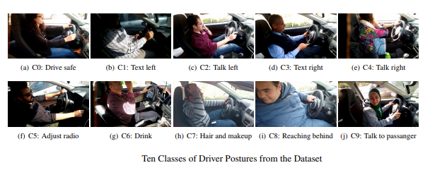
DATA CLASSES

Slide 7
METHODOLOGY
The project will be implemented by training a Convolutional Neural Network (CNN).
Deep Learning algorithm which can take in an input image, assign importance (learnable weights and biases) to various aspects/objects in the image and be able to differentiate one from the other.
The architecture of a ConvNet is analogous to that of the connectivity pattern of neurons in the human brain.

Slide 8
Building the Model
The model type being used is Sequential.
The easiest way to build a model in Keras.
Allows to build a model layer by layer.
There are 3 Conv2D layers, which are convolution layers that will deal with the input images, which are seen as 2-dimensional matrices.
32 nodes in the first 2 layers each and 64 nodes in the last layer.
Kernel size is the size of the filter matrix for convolution (3x3).
Activation function that is used is the ReLU, or Rectified Linear Activation.

Slide 9
Building the Model
There are 3 maxpooling layers.
Max Pooling is a sample-based discretization process.
Down-samples an input representation and reduces its dimensionality.
A max filter is applied (2x2).

Slide 10
Building the Model
In between the Conv2D layers and the dense layer, there is a ‘flatten’ layer.
Flatten serves as a connection between the convolution and dense layers.
‘Dense’ is the layer type that is used in the output layer.
There are 10 nodes in the output layer, one for each possible class (0–9).
The activation function is ‘softmax’.

Slide 11
Compiling the model
Compiling the model takes three parameters: optimizer, loss and metrics.
The optimizer, ‘Adadelta’ controls the learning rate.
Adadelta adapts learning rates based on a moving window of gradient updates, instead of accumulating all past gradients.
Learning rate determines how fast the optimal weights for the model are calculated.
The loss function used here is ‘categorical_crossentropy’.
A lower score indicates that the model is performing better.
‘accuracy’ metric is used to see the accuracy score on the validation set when we train the model.

Slide 12
Training the model
To train the model, the ‘fit_generator()’ function is used.
Parameters: training data, validation data, number of epochs and samples per epoch (20,924).
The number of epochs is the number of times the model will cycle through the data (20).

Slide 13
Saving The Model
The entire model is saved to a file that contains the weight values, the model’s configuration, and even the optimizer’s configuration.
This allows one to checkpoint a model and resume training later, from the exact same state, without accessing the original code.
To save the model, ‘model.save()’ function is used.

Slide 14
Using the model to make predictions
To see the actual predictions that the model has made for the test data, the ‘predict()’ function is used.
The function predicts which class each image in the test data belongs to.

Slide 15
RESULTS
For testing, 5 images are given to the model.
The model predicts which class each image belongs to, and prints the name of the class.
The accuracy score is 0.93.
The cross entropy loss rate is 0.2325.

Slide 16
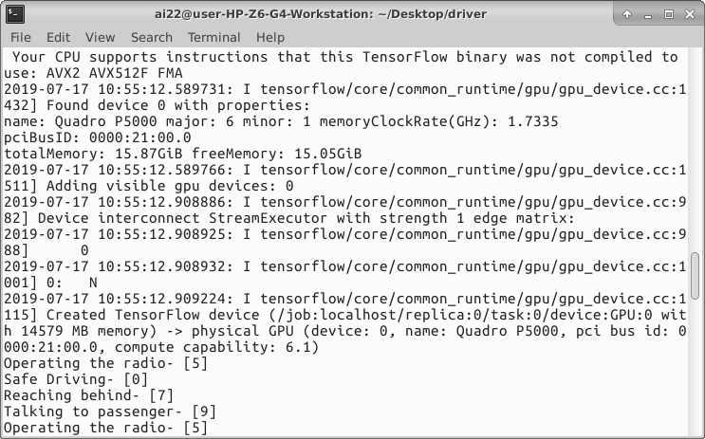
RESULTS

Slide 17
CONCLUSION
Driver distraction is a serious problem leading to large number of road crashes worldwide.
Hence detection of distracted driver becomes an essential system component in self driving cars.
A camera and dashboard can be installed in the car to monitor the driver’s driving.
These kinds of systems would be very useful for cab services providers like OLA and UBER.

Slide 18
SOURCE OF DATA
https://www.kaggle.com/c/state-farm-distracted-driver-detection/data

Slide 19
THANK YOU

